Slide 1
广州二测读后续写
坐轮椅的“超级英雄”

Slide 2
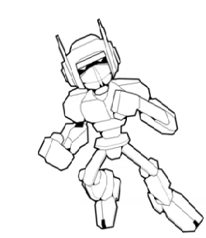

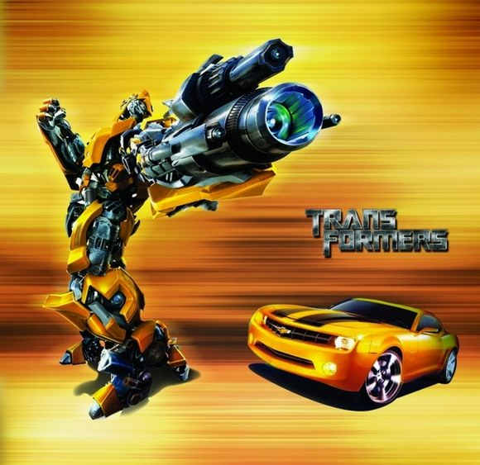
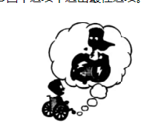
Do you want to be a super hero?
Jordan wanted very much to, but he was in a wheelchair...

Slide 3
Outside the Box
The Harvestfest contest was falling on Friday and everyone in school was talking about it. All the students would show up in their self-made costumes(装扮)and a winner would be chosen by the principal.
“Do you have your costume for the Harvestfest contest?"Alice asked."I'm going as a chocolate bar. My mom and I have been working on it all week.”
“Yeah, I have a costume,”said Jordan Eastman, popping up the two front wheels of his wheelchair as he waited for his dad to pick him up.“But it's boring.”
“Why? What is it?”Alice asked.
“MaxMag the superhero, but Danny, Tom and Izzy are all going as MaxMag too.” Jordan shook his head.“That's too many to stand a chance at winning the contest.”He waved to his dad, who had just pulled up in front of the school.
Jordan rolled his wheelchair toward his dad, and Alice walked with him to the minivan(小货车).
“Maybe you should go as something else.”
“The contest is Friday night.”Jordan sighed.“It's too late to change costumes.”
“Jordan, you have to think outside the box. Look around your house and see what you have. There's hidden potential in everyday items."She took a sip of her drink, and told Jordan that her chocolate-bar costume was made from old fabric her mom had lying around and recycled plastics.
On his way home, Jordan was quiet. He kept thinking about Alice's words: Think outside the box. There's hidden potential in everyday items. When he got home, he found his mum handling with some wooden pieces. She was putting a new desk together. On top of the desk was the huge empty cardboard box the pieces had come in. Mom smiled at Jordan, pointing at the desk,“What do you think?”

Slide 4

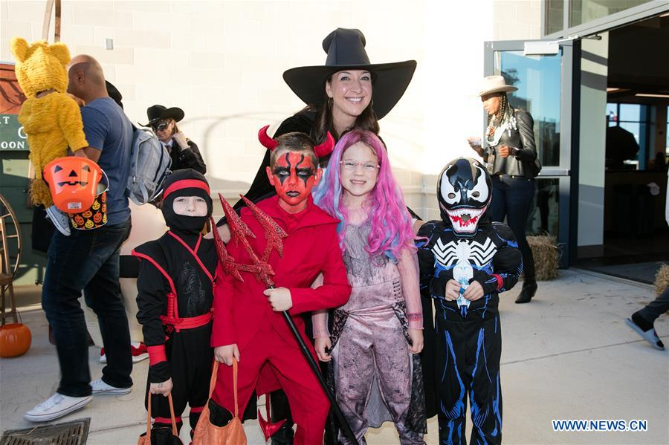
Background information

Slide 5
Read for settings
The contest is Friday night...
On his way home...
When he got home...
At school --
At home
Jordan had a costume for the Harvestfest contest,but it was
boring.
where
when
what
Jordan(main role)
Alice(main role)
Danny, Tom and Izzy
Jordan’s dad and mum
That's too many to stand a chance at winning the contest.
why
who

Slide 6
Read for plots
Jordan saw a new desk and a huge empty cardboard box.
delighted
Para 1: Jordan's eyes fell on the box and he smiled,"It's perfect . … with my wheelchair.”
Alice asked Jordan to think outside the box.
confused
Jordan’s costume was MaxMag but he thought it boring.
annoyed
Alice was going as a chocolate bar.
proud
Para 2: Soon it was Friday night, and Jordan couldn't wait to show his costume.
The Harvestfest contest was falling on Friday.
excited

Slide 7
Read for conflict
Conflicts
Possible endings
1. Jordan was chosen by the principal as the winner.
2. Jordan used the huge empty cardboard box to redesign his costume with his wheelchair.
3.Jordan learned to think outside the box and there's hidden potential not only in everyday items, but everyone,too.
1.Jordan wanted to win the contest, but he thought that's too many to stand a chance.
2.Alice suggested he should go as something else, but Jordan thought it was too late to change costumes.
VS
Will they respond to my request and offer help?

Slide 8
Read for clues
Clue | Foreshadowing
1. All the students would show up in their self-made costumes(装扮)and a winner would be chosen by the principal.
2. "I'm going as a chocolate bar. My mom and I have been working on it all week.”
3. “MaxMag the superhero, but Danny, Tom and Izzy are all going as MaxMag too.” Jordan shook his head.
4. “The contest is Friday night.”Jordan sighed.“It's too late to change costumes.”
5. “Jordan, you have to think outside the box. Look around your house and see what you have. There's hidden potential in everyday items."
6. On top of the desk was the huge empty cardboard box the pieces had come in.
1. “The winner of this year’s Harvestfest costume contest is ...”, the principal
contined, “Jordan Eastman!”
2. Alice in a chocolate bar showed up and recognised Jordan.
3. When he was waiting for his turn, he saw Danny, Tom and Izzy wearing the same MaxMag costumes.
4. “I am afraid that I won’t have enough time, could you please help me, mom?” “Sure,my dear!” Mom replied.
5. He came to realize a fact that there is hidden potential in everyday items, and also everyone.
6. Realizing Mom was confused, he quickly added, “That’s a cool desk, Mum. But can I have the big box for the Harvestfest contest?

Slide 9
Predict for writing
Para 1: Jordan's eyes fell on the box and he smiled,"It's perfect . … with my wheelchair.”
衔接句1：How do mom react?
情节推进（心理）：How do Jordan feel?
情节推进（动作）：How will Jordan and his mom make the new costume?
衔接句2：Did they succeed?
Para 2: Soon it was Friday night, and Jordan couldn't wait to show his costume.
1. 衔接句3：How do Jordan feel?
2. 情节推进（心理\动作）：What happened during the contest?
3. 结尾：Who is the winner of contest?
4. 主题升华：How to echo with the former part?
What is the theme of the story?

Slide 10
范文：
Jordan’s eyes fell on the box and he smiled, “It’s perfect…with my wheelchair.” Seeing the puzzled look on his mum’s face（神态描写）, Jordan quickly told her the design of his new costume — MaxMag on his car. She smiled and gave him a thumbs up. “No time to wait! Let’s get started!” exclaimed his dad who just went in. For two nights, they cut, pasted, folded and unfolded the box; they drew on it and colored it to make it look like a real car; and they glued the old MaxMag costume onto it.（动作描写） When the new costume was finally ready, Jordan tried it on several times and continued to make necessary changes until satisfied.

Slide 11
范文：
Soon it was Friday night, and Jordan couldn’t wait to show his costume. When he wheeled himself into the party, he immediately spotted the three MaxMags. When they saw him, they couldn’t believe it. “The MaxMag and his car? That’s awesome!” Danny’s eyes lit up. “The wheels of your chair are just perfect!” said Tom. “You even have the headlights! It’s so cool.” Izzy pointed to the front. Jordan beamed. “Thanks!” When it was time to announce the winner, Jordan joined his friends by the stage. “The winner of this year’s Harvestfest costume contest is ...”, the principal paused to read the name off the card, “Jordan Eastman!” （伏笔照应）Everyone clapped. “See? You just needed to be creative!” Alice said. “You mean think outside the box!”（主题呼应） Jordan patted on the flaming-red car attached to his chair, with an iconic MaxMag smile.

Slide 12
References 2
Jordan’s eyes fell on the box and he smiled, “It’s perfect … with my wheelchair.” Realizing Mom was confused, he quickly added, “That’s a cool desk, Mum. But can I have the big box for the Harvestfest contest?” He then explained excitedly how to turn it into a mobile refrigerator. “Brilliant! You will definitely be the superhero of the party, serving people their favourite drinks,” Mum exclaimed with a broad smile. In the following days, his priority after school was designing and making the new costume, fixing it to his wheelchair and exquisitely making a door. Finally, he even prepared some soft drinks to surprise his friends.

Slide 13
References 2
Soon it was Friday night, and Jordan couldn’t wait to show his costume to his friends. When he wheeled himself in as a mobile refrigerator, he heard admiring exclamations, guessing about who it would be. Jordan felt an increasing sense of pride and satisfaction. When he spotted a chocolate bar, he quickly moved towards it, stopped just several inches in front and quickly opened the door. “Jordan, it’s you!” Alice cried out. Jordan passed her her favourite drink. “Thank you, Alice. That’s an idea outside the box.” That night, although he didn’t win the best costume award from the principal, Jordan felt like the real MaxMag: his body and soul were no longer confined to the wheelchair. And he came to realize: there is hidden potential in everyday items, and so it is with every individual.

Slide 14
下水作文：
Jordan’s eyes fell on the box and he smiled, “It’s perfect…with my wheelchair.”Hearing what he said, mom asked with a puzzled look， “What do you mean?” Jordan explained the whole thing to mom. Mom clapped her hands in excitement and replied，“Let’s do it now！” They cut a hole on the top of the box, fixed it on the wheelchair and decorated it with the Maxmag costume. （动作描写）After what seemed like a century, they were so exhausted to move an inch. The wheelchair now looked like a moving Maxmag car. A glimmer of hope sparkling in Jordan’s eyes, he couldn’t help imagining standing on the stage（情绪描写）.

Slide 15
下水作文：
Soon it was Friday night, and Jordan couldn’t wait to show his costume. Students took turns to show their self-made costumes. There were several Maxmags, and in front of Jordan was Alice’s chocolate bar（伏笔照应）. Soon it was time for Jordan to stand on the stage. With his outstanding Maxmag car, everyone’s eyes were fixed on him. Excitement gave way to anxiety as Jordan sensed the complete silence. Suddenly, Thunderous appaluse burst out from the audience. Jordan was no doubt the winner! Though he was sitting in the box now, he really thought outside the box! （伏笔照应）

Slide 16
相似“成长”类
续写考题对比

Slide 17
Today was Community Service Day at school. Maya’s class was going to make cards for the seniors living in a nursing home. It was also the first day Maya would be wearing her leg brace (腿支架) to school, which was designed to help her walk more steadily and smoothly.
It was a cold autumn morning. Maya looked down, feeling embarrassed. To make it lovelier, she had delicately decorated the brace with pretty butterfly patterns. Still, she was unsure about others‘ reaction. All morning at school, kids kept glancing at her brace. To her relief, they didn’t say anything.
In the classroom, Maya was drawing little green buds (芽) and pretty flowers when her friend Samir came over and sat by her. She felt his eyes fixed on her brace and heard him asking, “What’s that for?” Not knowing what to say, Maya pretended she didn’t hear him. After a few seconds of awkwardness, she glanced back at him, and found that he looked a little sad.
After lunch, the class set off. The nursing home was on a small hill and all of them walked there happily along the path. Maya found that the brace did make it easier for her to walk up.
Maya and Samir were paired up with a lady who was 83 years old. There at the end of the hall in a wheelchair, with a big smile on her face, sat the lady, wearing a pink coat, with red lipstick and beautiful earrings. She looked bright and full of life. Moving flexibly and fast towards Maya and Samir, she greeted first. “I’m Joan,” she said cheerfully, “Glad to meet you.”
Maya and Samir handed her the cards they made. Joan looked at Samir’s card carefully and spoke with admiration, “You’ve written a poem! That’s so artistic!” Samir’s face reddened with shyness. Then Joan turned to Maya’s picture. “The first flowers of spring!” she cried in delight. “You really have a gift for using colour!” she said. Clearly, Joan’s praise added great power into Maya. （2023深圳一模）

Slide 18
范文赏析
In a sudden wave of bravery, Maya asked, “What’s it like being in a wheelchair?” “It helps me get around,” Joan said simply. Then, grinning, she added, “You’d be surprised at how fast I can go in this thing!” Right then, she moved the wheelchair across the room, turning around, back and forth. And what surprised Maya most was that she didn’t detect any pity or embarrassment from her. Then Maya looked up and found Joan was smiling, eyes purposefully resting on her brace. It was then that a spark of power was lit up deep inside Maya. That afternoon, the three of them had a pleasant talk over lots of things until it was dusk.
Deeply impressed by Joan, Maya offered to sit beside Samir on the bus ride back home. “Joan is great. I like her.” Samir admired. Maya nodded, lost in thought. With Joan’s wheelchair and smile in mind, she summoned up her courage and said, “The brace keeps my toe up so I can walk better.” “Really?” Samir looked amazed, reached out and touched it gently. “That’s super cool!” His words were so sincere that Maya felt warm and moved. It was a reaction that she expected deep inside her heart. Though it was autumn outside, it felt like spring for Maya. A little green bud was bursting — she and her brace looked cool, beautiful and dynamic in her and others’ eyes.

Slide 19
原文赏析与练习

Slide 20
浙江省温州市鹿城区2023年初中毕业升学适应性测试
“Do you have your costume for the Harvestfest competition?” Meg asked.
“I have one—Magnifico, 1 favourite hero,” said Jordan, sitting in his wheelchair. “But it’s boring.”
Meg shrugged. “You love Magnifico. What’s the matter?”
“Danny and Alex are going as Magnifico, too.” Jordan shook his head. “It’s 2 for me to win.”
Meg said, “Maybe you should go as 3 different.”
“The competition is Friday night. It’s too late to change costumes,” Jordan sighed.
Back at home, Jordan was quiet, thinking about Meg’s words 4 . When he pulled into Mom’s home office, he saw papers and books everywhere. “What are all these?” he asked.
“I’m cleaning out my old desk. The new one is arriving tomorrow.” She smiled at Jordan. “What’s on your mind?”
Jordan explained the costume situation. “I really want to be the 5 .”
“We have lots of old clothes and costumes. Why not take a look?” Mom 6 .
“OK.”
Jordan found giant sunglasses and a long black wig, 7 nothing was useful.
The next day, Meg found him. “Any new idea?”
“I 8 some old clothes.” He shrugged. “Nothing.”
“Jordan, you have to think outside the box,” said Meg. “See what you have 9 your house. There’s hidden potential in everyday items. My candy-bar costume is made from recycled aluminum foil.”
When Jordan got home, he found Mom putting her new desk together. On top of the desk was a giant box. Suddenly, he 10 what Meg said—think outside the box.

Slide 21
“What do you think?” Mom asked, pointing to her desk. Jordan’s eyes fell on the 11 . He grinned. “It’s perfect!”
On Friday night. Jordan was fully prepared for the competition. When Danny and Alex saw Jordan, they 12 believe his costume.
“The Magnifico Mobile?” Danny’s eyes lit up. “The wheels of your wheelchair are perfect for its back wheels.” He wondered 13 Jordan made it.
Jordan beamed. “Thanks! I got the idea from a box.”
It was time to announce, the 14 . “The winner is... Jordan Eastman!” Everyone clapped.
“See?” Meg said. “You just needed to be 15 !”
“Yeah, think outside the box!” Jordan smiled.
1. A. my B. his C. her D. your
2. A. possible B. difficult C. important D. dangerous
3. A. nothing B. anything C. something D. everything
4. A. secretly B. angrily C. proudly D. carefully
5. A. judge B. winner C. officer D. player
6. A. ordered B. guessed C. suggested D. promised
7. A. or B. so C. if D. but
8. A. took off B. paid for C. threw away D. looked through
9. A. for B. around C. outside D. beside
10. A. recorded B. doubted C. discovered D. remembered
11. A. box B. desk C. clothes D. sunglasses
12. A. mustn’t B. needn’t C. couldn’t D. shouldn’t
13. A. why B. how C. when D. where
14. A. goal B. rule C. result D. subject
15 A. polite B. helpful C. creative D. humorous
1-5 ABCDB
6-10 CDDBD
11-15 ACBCC

Slide 22
表演比赛类语料积累

Slide 23
一．表演比赛前的练习准备
1) 我立刻开始追求完美主义，把台词的声音从我嘴里脱口而出。（2023届广东省大湾区第一次联考）
I immediately engaged in the pursuit of perfectionism for the sounds of the lines blurted out from my mouth.
2）我一直专注在提炼每一个音高和音调的细微差别，直到它们在我的耳朵里听起来完美为止。（2023届广东省大湾区第一次联考）
I kept my hand in refining each nuance of pitch and tone of the line until they sounded perfect to my ears.
3）我帮助三个新女孩，和他们一起做拉拉队员的基本训练。（宁波市2022学年第一学期高考与选考模拟考）
I helped three of the new girls and worked with them on our basic practice of cheerleaders.

Slide 24
二．表演比赛前的情绪描写
1）自我怀疑的螺旋积聚在我的心中，以压倒我(2021.12八省联考T8）。
My turn finally came. Spirals of self-doubt accumulated into my heart in order to overwhelm me.
2） 当我内心平静地发出无助的声音时，我的脸上顿然失色。(2022届杭州二中高三月考)
Blood drained from my face as my inner self made quiet sound of helplessness.
3)观众们发出的低语声似乎是十倍。我的胃像是打结了，担心紧紧抓住了我。(2022届杭州二中高三月考)
The little murmurs from the audience felt like they were multiplying tenfold. As my stomach was in knots, worry took a tight grip on me.

Slide 25
三．表演比赛时的动作描写
1) 大卫伸展四肢，前后摆着手臂，向目的地飞跑。三步飞奔，他成功了。他喘着粗气，马上停下，吸气。（2022年新高考1卷）
David stretched his limbs, pushing his arms back and forth, as he jetted towards the destination. Three more leaps and he made it. He breathed heavily and stopped momentarily to catch his breath.
2）就在莎莉做白日梦的时候，旋转的球突然在她面前滚动。抓住这一宝贵而重要的时刻，她自动向后倾斜，调整身体位置，并将支撑腿放在球后面。向上射门，进球了。（2021年深圳市高三年级第一次调研考试）
Just when Sally was day dreaming, out of blue the rotating ball rolled abruptly in front of her. Seizing the precious and vital moment, she automatically leaned backward to position her body and placed her support leg behind the ball. With an upward direction to shoot, a goal was scored.

Slide 26
四．表演比赛的主题升华
1）服务他人胜于比赛胜负（2022年4月广东六校第四次联考）
看到我的音乐给别人带来的冲击和力量，我感到胜利，这是平时的独奏会无法获得的。
Seeing the impact and power that my music brought to others, I felt triumphant that couldn’t be gained from the usual recital. 2) 友谊与比赛(2021年11月高三9+1联盟) 真正的朋友是我们可以忍受的愚蠢的朋友。
True friends were the ones that we could afford to be stupid with.
3）比赛的含义(2022年新高考1卷）
如果你不会飞，那就跑吧。如果你不能跑，那就走路。如果你不能走路，那就爬行。但无论你做什么，都要继续前进。
If you can’t fly, then run. If you can’t run, then walk. If you can’t walk, then crawl. But whatever you do, just keep moving forward.

Slide 27
Thank You !

